Slide 1
Computer Organization & Architecture

Slide 2
Introduction
This course is all about how computers work
But what do we mean by a computer?
Different types: desktop, servers, embedded devices
Different uses: automobiles, graphics, finance, genomics…
Different manufacturers: Intel, Apple, IBM, Microsoft, Sun…
Different underlying technologies and different costs
Best way to learn:
Focus on a specific instance and learn how it works
While learning general principles and historical perspectives

Slide 3
Why learn this ?
You want to call yourself a “computer engineer”
You want to build software people use (need performance)
You need to make a purchasing decision or offer “expert” advice
Both Hardware and Software affect performance:
Algorithm determines number of source-level statements(effificent algo)
Language/Compiler/Architecture determine number of machine instructions optimizing compilers)
Processor/Memory determine how fast instructions are executed (high)performance implementations on architecture
I/O and Number_of_Cores determine overall system performance

Slide 4
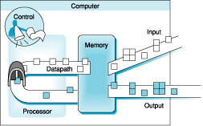
Organization of a Computer
Five classic components of a computer – input, output, memory, datapath, and control
datapath + control = processor

